Slide 1

CUSTOMER SHOPPING TRENDS

Slide 2

INTRODUCTION

Slide 3
ABOUT THE DATASET
The dataset contains customer information with unique IDs, demographics (age, gender), purchase details (item, category, amount, location, size, color, season), review ratings, subscription status, shipping preferences, discount usage, promo codes, previous purchase counts, preferred payment methods, and purchase frequency. This comprehensive dataset enables the exploration of diverse customer shopping trends and behaviors.
COMPRISING 4100 ROWS AND 18 COLUMNS,

Slide 4
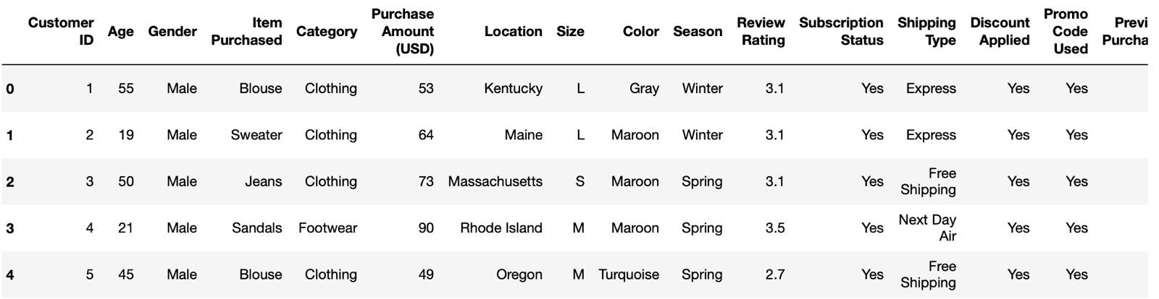
DATASET

Slide 5
EXPLORATORY DATA ANALYSIS

Slide 6
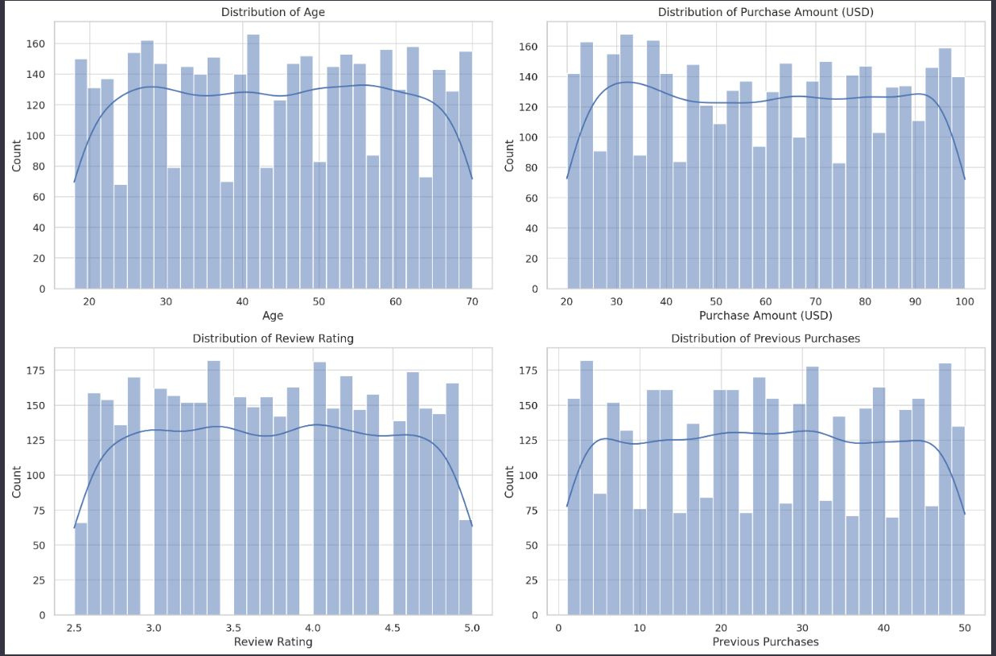
HISTOGRAMS

Slide 7
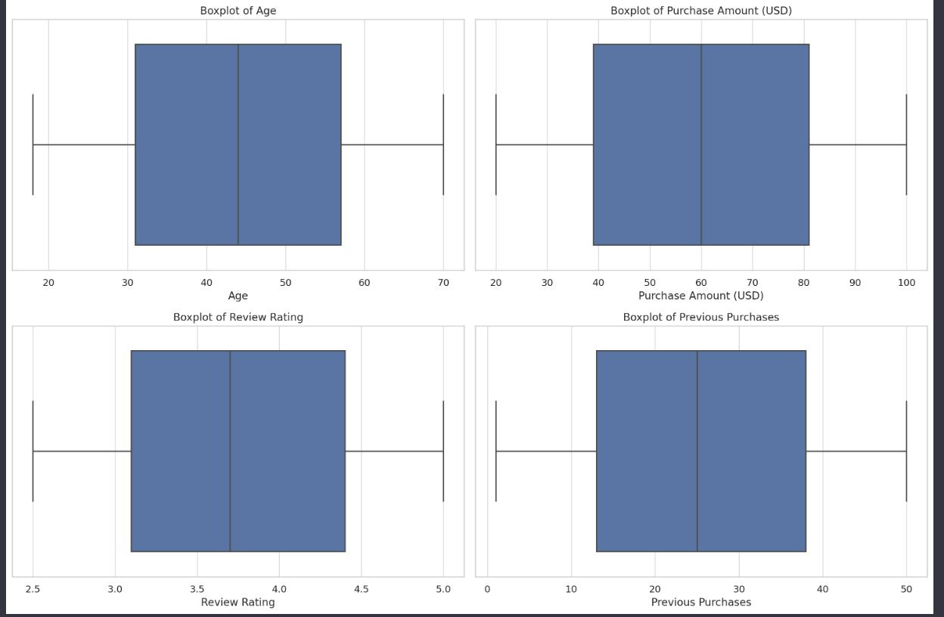
BOX PLOTS
These boxplots indicating that there are no significant outliers in these numerical columns.

Slide 8
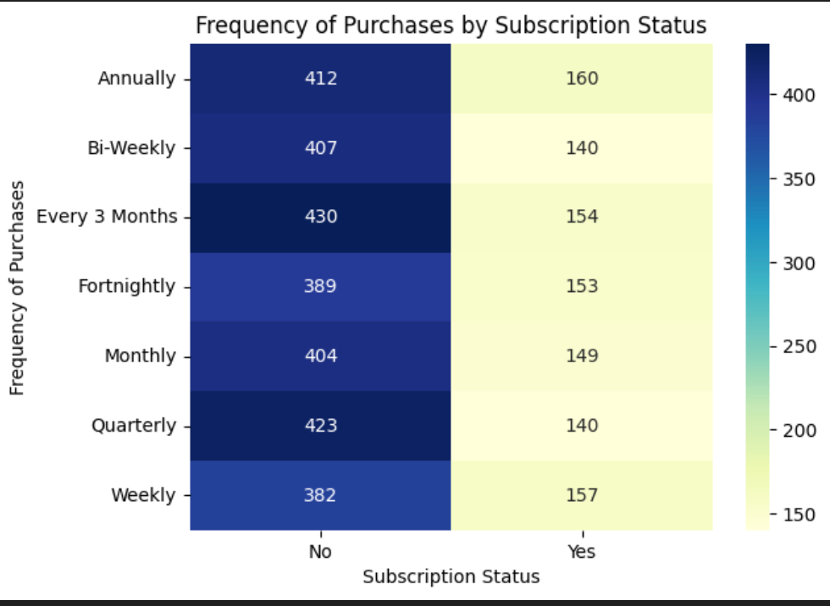
Heatmap of Frequency VS Subscription Status

Slide 9
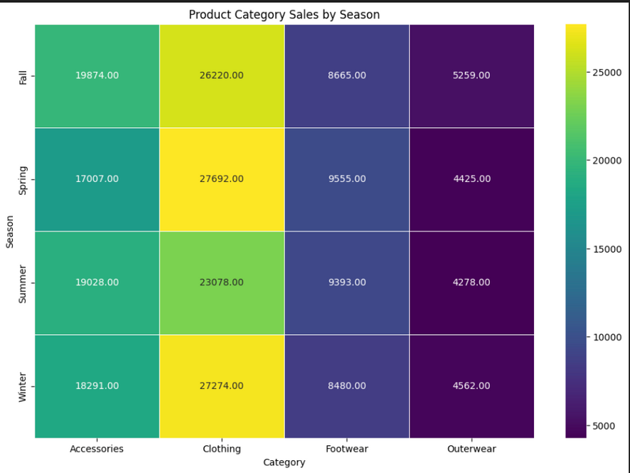
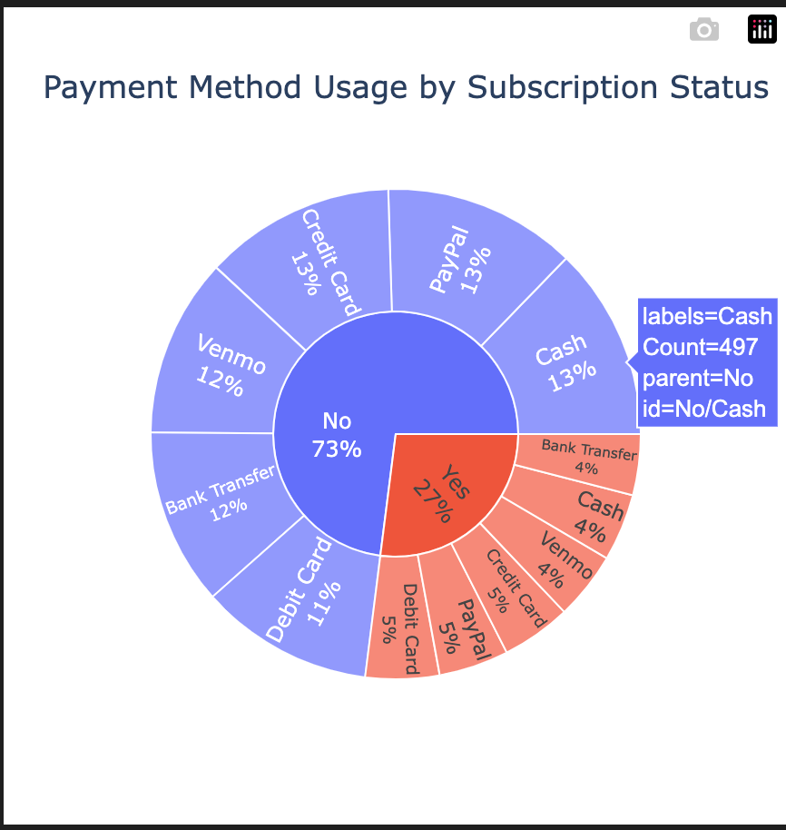
Product Category Sales by Season
Subscription status vs Payment Method

Slide 10
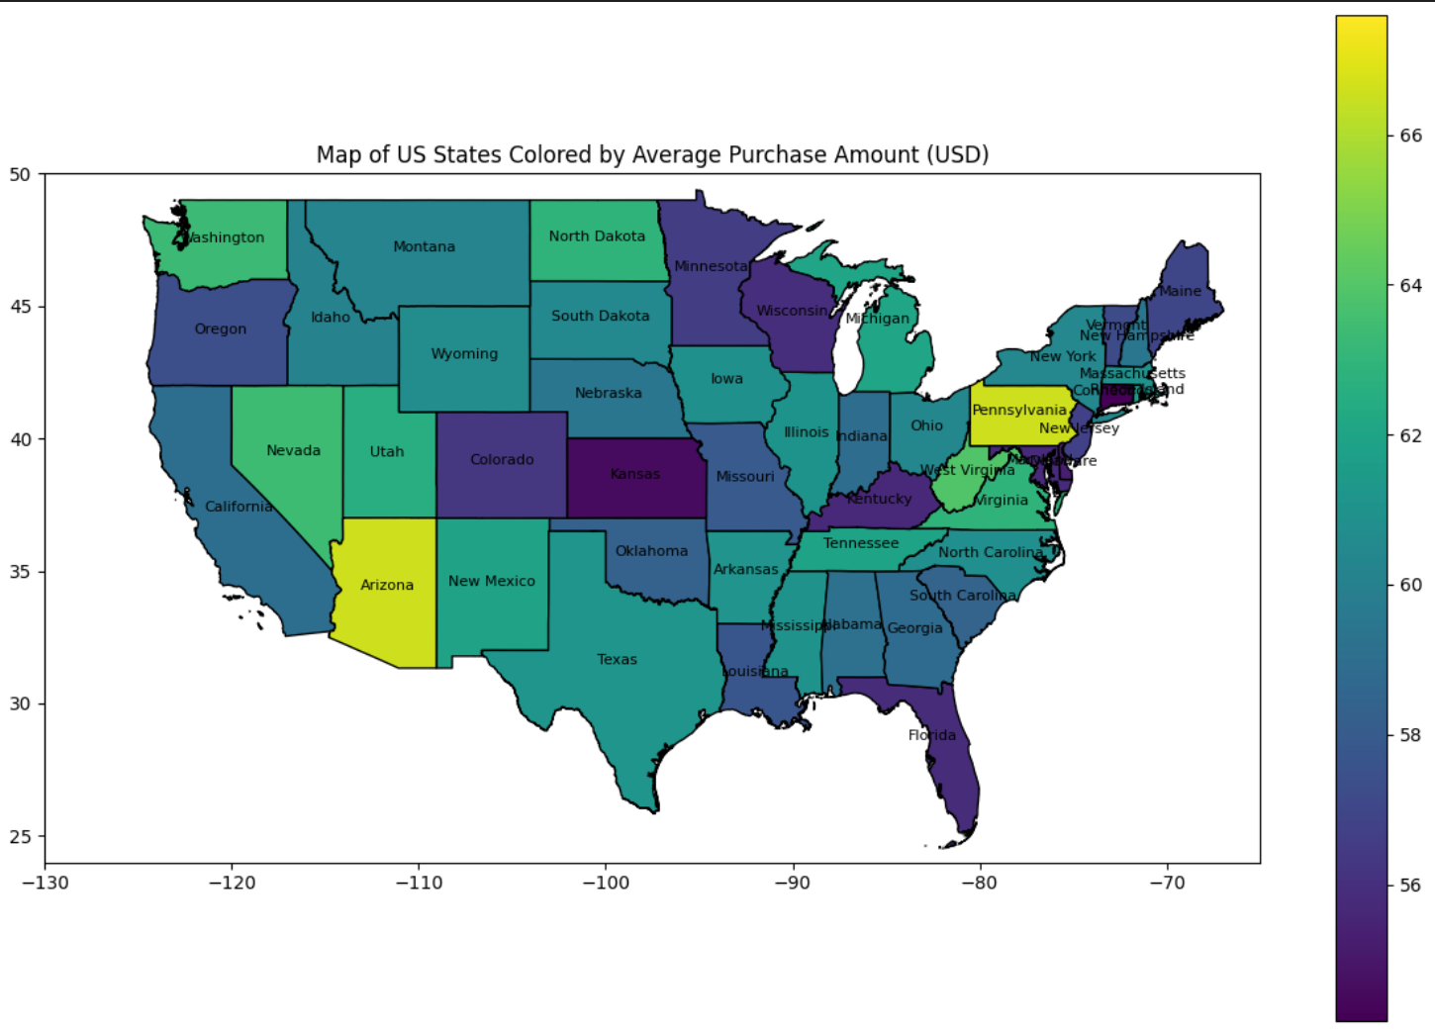
Your paragraph text
Maps Of Location Colored By Average Purchase Amount
xt

Slide 11
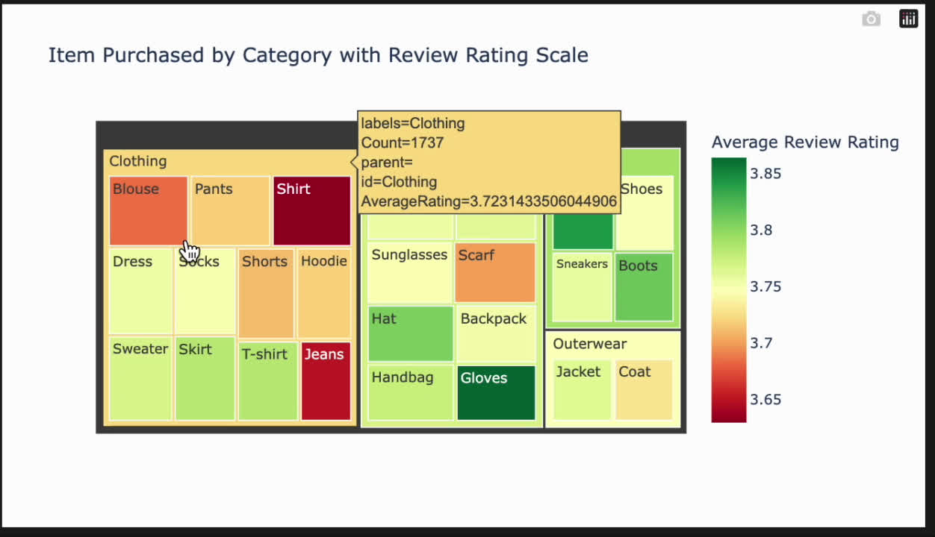
Tree Map

Slide 12
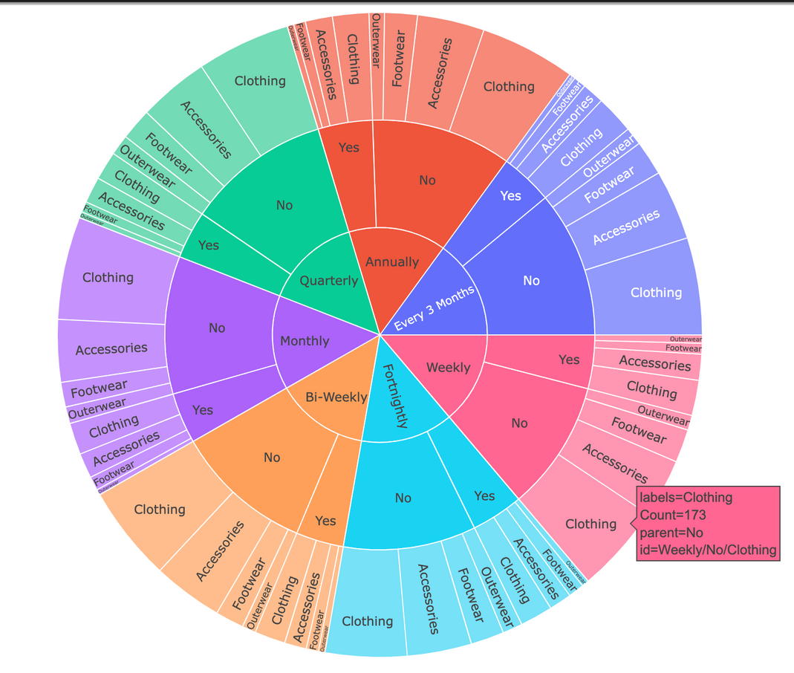
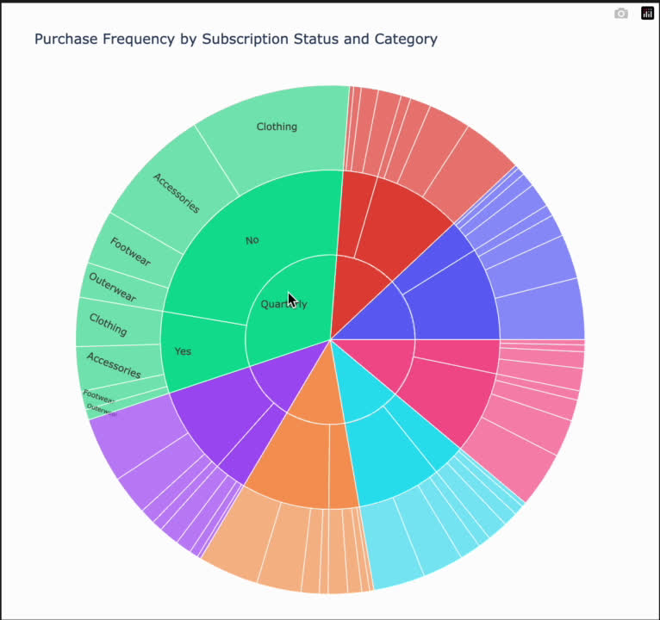

MULTIVARIANT ANALYSIS
Frequency Of Purchases VS. By Subscription VS Catrgory

Slide 13
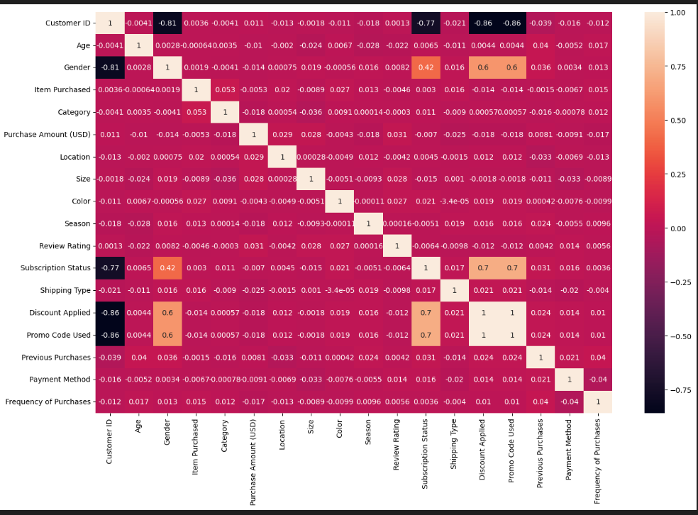

Corelation between Purchases VS Subscription Status

Slide 14
MODELS

Slide 15
SMOTE ANALYSIS
SMOTE is a specific type of oversampling that generates synthetic examples for the minority class rather than duplicating existing instances.
Using SMOTE with logistic regression can be particularly beneficial when dealing with imbalanced datasets, as it helps to alleviate issues related to biased models and poor generalization on the minority class.
Variance Inflation Factor (VIF) and Multicollinearity:VIF quantifies the extent of multicollinearity in regression models by measuring how much the variance of an estimated regression coefficient increases if predictors are correlated.

Slide 16
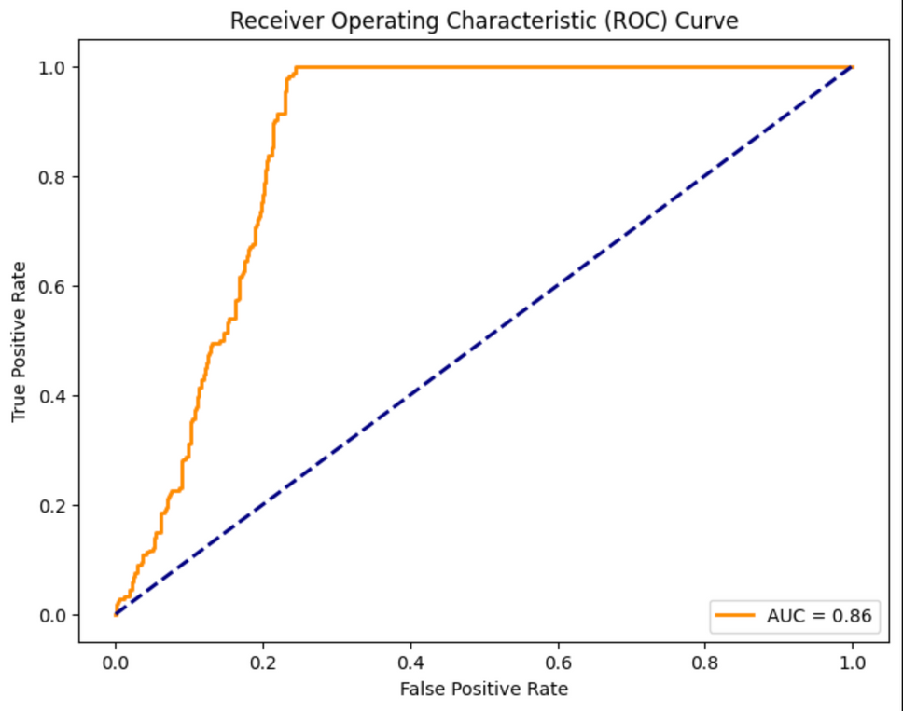
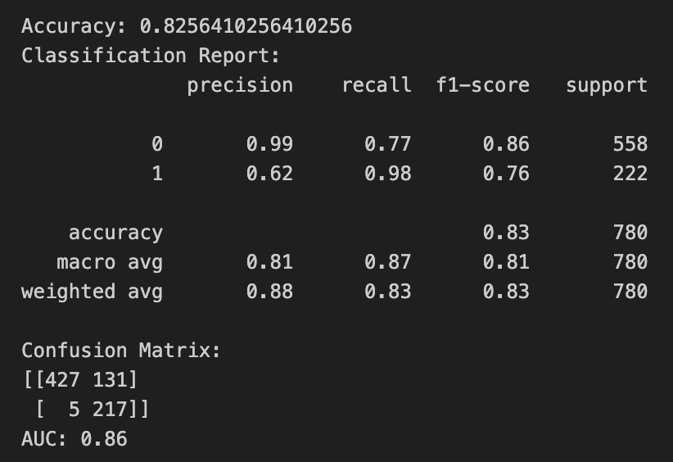

Logistic Regression
ROC CURVE
Results

Slide 17
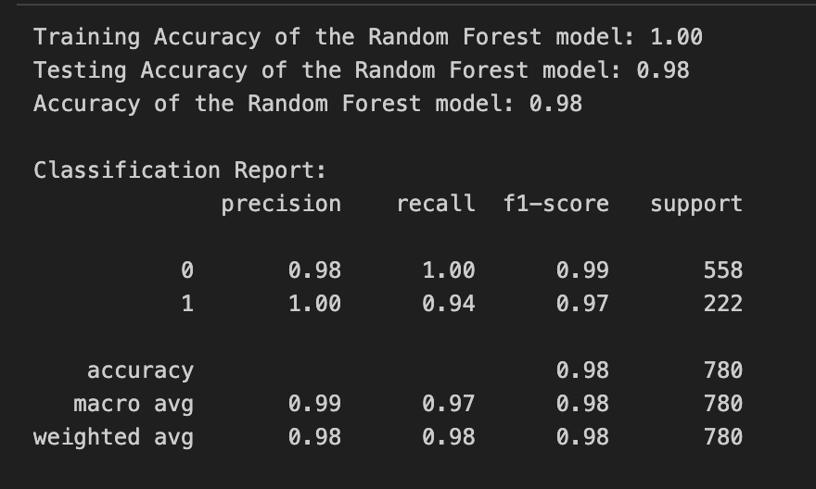

Random Forest
RESULTS

Slide 18

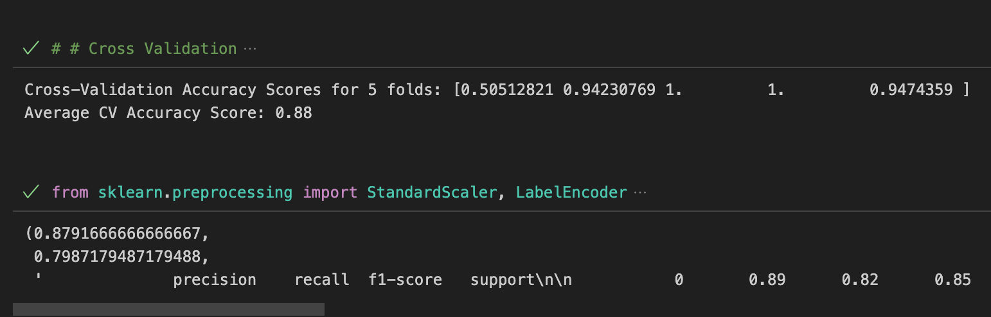
CROSS VALIDATION

Slide 19
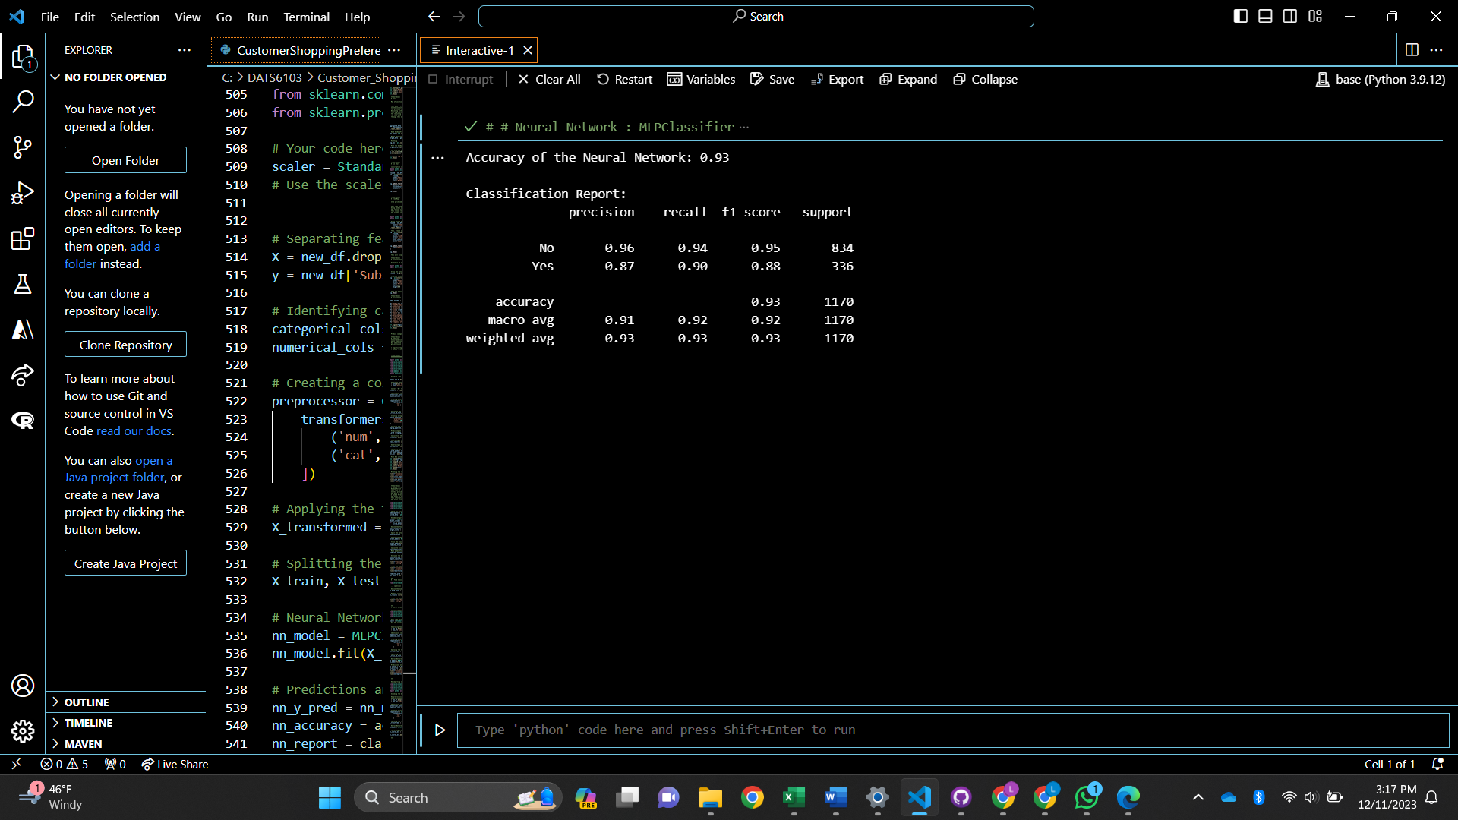
Neural Network

Slide 20
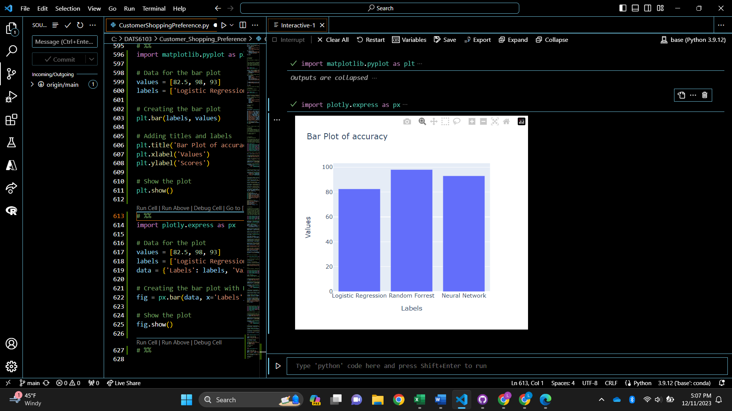
RESULTS

Slide 21


